Slide 1
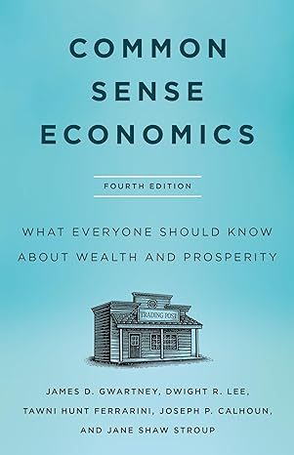
PART 2: SEVEN MAJOR SOURCES OF ECONOMIC PROGRESS
Common Sense Economics ~
What Everyone Should Know About Wealth and Prosperity
http://CommonSenseEconomics.com/

Slide 2
INTRODUCTION TO POWERPOINT SLIDES
The PowerPoint slides for the Common Sense Economics (CSE 4.0) electronic package provide an overview of the most important points covered in the text. Students should read the text, watch the assigned videos, and listen to the podcasts prior to reviewing the slides.
  CSE Slide Overview: Identification of essential elements, key concepts, and economic content standards featured in text, videos, podcasts, and interactives.
  Module Organization: Slides by module for weekly coverage; 15 core modules. Includes titles, concepts, highlights, and questions.
  Classroom Use: Ideal for instruction and learning. Offers comprehensive notes and explanations on CSE text that can be used by the course instructor or students. Instructors are encouraged to customize.

Slide 3
MODULE 5: LEGAL SYSTEM AND THE COMPETITIVE PROCESS
CSE 2.1, 2.2 Sources of Progress
CSE 2.1 Legal system: The foundation for economic progress is a legal system that protects privately owned property and enforces contracts in an even handed manner.
CSE 2.2 Competitive markets: Competition promotes the efficient use of resources and provides the incentive for innovative improvements.

Slide 4
MODULE 5: LEGAL SYSTEM AND THE COMPETITIVE PROCESS
CSE 2.1, 2.2 Concepts and Standards
CSE KEY CONCEPTS
Legal system and private ownership; Private property and incentives; and Competitive process; Economic growth: record and importance
ECONOMIC STANDARDS
Competition among sellers usually lowers costs and prices, and encourages producers to produce what consumers are willing and able to buy. Competition among buyers increases prices and allocates goods and services to those people who are willing and able to pay the most for them. (Standard 9: Competition and Market Structure, PDF)
Institutions evolve and are created to help individuals and groups accomplish their goals. Banks, labor unions, markets, corporations, legal systems, and not-for-profit organizations are examples of important institutions. A different kind of institution, clearly defined and enforced property rights, is essential to a market economy. (Standard 10: Institutions, PDF)

Slide 5
WHY IS ECONOMIC GROWTH IMPORTANT?
Robert Lucas, the 1995 Nobel laureate, stated, “Once you start thinking about economic growth, it is hard to think about anything else.”
Why do economists place so much emphasis on economic growth? Answer: Growth of real output is necessary for the growth of real income. Without growth, higher income levels and living standards cannot be achieved.
Throughout most of human history, economic growth has been extremely rare, but this began to change around 1800.

Slide 6
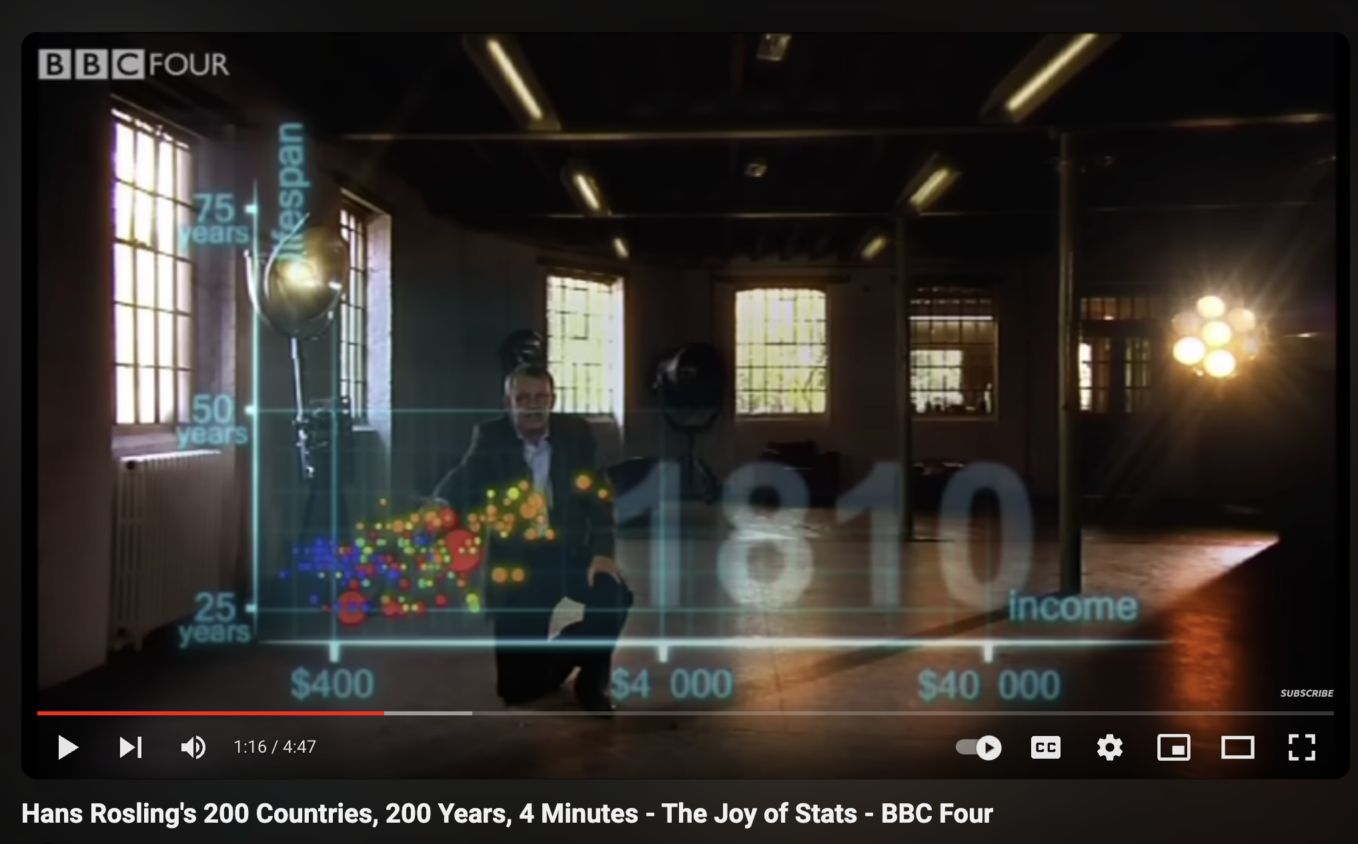

200 COUNTRIES, 200 YEARS
VIDEO WITH HANS ROSLING
The last 200 years transformed the world. Before 1809, every country had a life expectancy below 40 years and an annual income per person under $3000. Why is that?
What does prosperity have to do with sound institutions and incentives?

Slide 7
PER CAPITA INCOME: THE LAST 1000 YEARS
Per capita income changed very little for centuries prior to 1800, but growth has exploded during the last 200 years.
(Measured in 1990 dollars) world per capita income was $667 in 1820—only about 50% higher than year 1000. By 2003, however, income had risen to $6,516—10 times the 1820 level.
During the past 200 years, the income growth of the high-income industrial countries (west) has been even higher–nearly 20 fold.
$25,000
GDP Per Capita (1990 dollars)
2003: $23,710
$20,000
West GDP per capita
$15,000
2003: $6,516
$10,000
World GDP per capita
1820: $1,202
$5,000
1820: $667
1000
1100
1200
1300
1400
1500
1600
1700
1800
7
1900
2003
Source: Angus Maddison, Contours of the World Economy, 1-2030AD: Essays
in Macro-Economic History (Oxford: Oxford University Press, 2007)

Slide 8
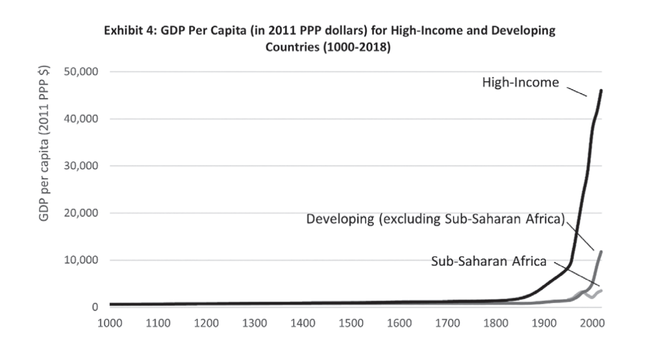

Slide 9
LIFE EXPECTANCY: THE LAST 1000 YEARS
The pattern of life expectancy is similar to that of per capita income.
Life expectancy at birth
for the world rose from
24 to 26 years between 1000 and 1820, but it soared to 64 by 2003.
Life expectancy in the high-income industrial countries (West) followed a similar pattern.
Life Expectancy
(at birth)
80
70
2003: 76
60
2003: 64
50
1820: 36
40
West life expectancy
30
20
World life
expectancy
1820: 26
10
1000
1100
1200
1300
1400
1500
1600
1700
1800
1900
2003
Source: Angus Maddison, Contours of the World Economy, 1-2030AD: Essays
in Macro-Economic History (Oxford: Oxford University Press, 2007)

Slide 10
CSE 2.1.
LEGAL SYSTEM: THE FOUNDATION FOR ECONOMIC PROGRESS IS A LEGAL SYSTEM THAT PROTECTS PRIVATELY OWNED PROPERTY AND ENFORCES CONTRACTS IN AN EVENHANDED MANNER.
[A] private property regime makes people responsible for their own actions in the realm of material goods. Such a system therefore ensures that people experience the consequences of their own acts.
— Tom Bethell, Economic Journalist

Slide 11
PRIVATE PROPERTY RIGHTS
Private ownership of property involves three things:
  Exclusive use: Owners of private property can decide how their property will be used.
  Protection against invaders: Others are prohibited from using the property without the owner's permission.
  Transferability: Owners have the right to buy, sell, or derive income from their land, natural resources, capital, and entrepreneurial talent.
Private ownership makes people accountable for their actions.

Slide 12
PRIVATE OWNERSHIP AND INCENTIVES
The most important aspect of private ownership is the incentives it creates. There are four major reasons why private ownership propels economic growth and progress.
Private ownership:
  Provides people with a strong incentive to maintain and care for their property.
  Encourages people to use and develop their property in ways others value highly.
  Makes owners legally responsible for damages imposed on others as the result of how their property is used.
  Promotes the conservation of resources for the future.

Slide 13
PRIVATE OWNERSHIP AND DOOMSDAY FORECASTS
For centuries pessimists have argued that the world is about to run out of various critical resources (e.g. trees, minerals, and energy sources). Why have they been wrong?
When the scarcity of a privately owned resource increases, the invisible hand of the market takes over. Prices rise setting into motion a flurry of activity.

Slide 14
PRIVATE OWNERSHIP AND DOOMSDAY FORECASTS CONTINUED…
The increase in price provides consumers, producers, innovators, and engineers with incentives to
  Conserve on the direct use of the resource,
  Search more diligently for substitutes, and
  Develop new methods of discovering and recovering larger amounts of the resource.
To date these forces have pushed doomsday forecasts ever farther into the future, and there is every reason to believe that they will continue to do so for resources that are privately owned.

Slide 15
LEGAL SYSTEM AND PRIVATE OWNERSHIP
A legal system that protects property rights and enforces contracts in an evenhanded manner provides the foundation for gains from trade, capital formation, and resource development, which comprise the mainsprings of economic growth.
Other forms of ownership have been tried. However, none provide as much freedom and incentive to serve others and use resources efficiently as private ownership within the framework of the rule of law.

Slide 16
CSE 2.2. COMPETITIVE MARKETS: COMPETITION PROMOTES THE EFFICIENT USE OF RESOURCES AND PROVIDES THE INCENTIVE FOR INNOVATIVE IMPROVEMENTS.
Competition is conducive to the continuous improvements of industrial efficiency. It leads producers to eliminate wastes and cut costs so that they may undersell others. It weeds out those whose costs remain high and thus operates to concentrate production in the hands of those whose costs are low .
— Clair Wilcox,
Former Professor of Economics
Swarthmore College

Slide 17
THE COMPETITIVE PROCESS
Competition is present when the market is open and alternative firms are free to enter and compete.
Competition encourages firms to:
  supply goods and services consumers value highly relative to cost and
  produce efficiently (keep their costs low).
Competition weeds out firms that fail to provide consumers with quality goods at competitive prices.

Slide 18
CONSUMERS RULE!
Consumers Vote on Which Businesses Stay and Which Must Go Using Their Dollars.
  Consumer purchases translate into business revenue.
  Producers will supply those goods and services consumers value enough to pay a price sufficient to cover the cost of the resources required for their production.
  Producers who fail to do this will make losses and be driven out of business. Profits and losses decide which firms will survive and what goods will be produced.

Slide 19
COMPETITION AND INNOVATION
In a market economy entrepreneurs are free to innovate. They need only the support of investors (often including themselves) willing to put up the necessary funds.
If consumers value the innovation enough to cover its costs, the new business will profit and prosper.
But if consumers find that the new products are worth less than their costs, the businesses will suffer losses and eventually fail.
Consumers are the ultimate judge and jury of business innovation and performance.

Slide 20
COMPETITION, BUSINESS STRUCTURE, AND SIZE OF FIRM
Competition discovers the business structure and size of firm that can best keep the per-unit cost of a product or service low.
Business structure:
  Unlike other economic systems, a market economy does not mandate the types of firms that are permitted to compete.
Size of firm:
  In some sectors—the manufacturing of airplanes and automobiles, for example—firms will need to be quite large to take full advantage of economies of scale.
  In other sectors, however, small firms will be more cost-effective. When consumers place a high value on personalized service small firms generally dominate.

Slide 21
COMPETITION, BUSINESS, AND GOVERNMENT
Competition is not pro-business.
Businesses often lobby government officials requesting favors that will limit competition.
Government regulations that limit entry into markets and favor some businesses over others undermine the competitive process.

Slide 22
SELF-INTEREST AND COMPETITION
When Directed by Competition, Self-Interest is a Powerful Force for Economic Progress.
It is not from the benevolence of the butcher, the brewer, or the baker that we expect our dinner, but from their regard to their own self-interest. We address ourselves not to their humanity but to their self-love, and never talk to them of our own necessities, but of their advantages.
—Adam Smith, Wealth of Nations, 1776

Slide 23
MODULE 5: QUESTIONS FOR THOUGHT
Does private ownership entitle the owners to do anything they want with their property? Why or why not?
What would happen to the size of the cattle population if Americans decided to eat substantially less beef? Explain the logic underlying your answer.

Slide 24
MODULE 5: QUESTIONS FOR THOUGHT
“The quantity of non-renewable resources such as oil, natural gas, copper, and iron ore is fixed. Unless we begin to reduce our consumption of these and other minerals, we will soon run out of them.” Is this true? Explain.
In a competitive market, what must a firm do in order to be successful? What happens to firms that fail to provide consumers with desired goods at prices equal to or less than those available from other firms? Is this good or bad?

Slide 25
MODULE 6: REGULATION, CAPITAL MARKETS, AND MONETARY STABILITY
CSE 2.3, 2.4, 2.5 “Sources of Progress”
CSE 2.3 Minimal regulation: Regulations that increase market competitiveness or support voluntary exchange spur progress.
CSE 2.4 Efficient capital markets: To realize its potential, a nation must have a mechanism that channels capital into wealth-creating projects.
CSE 2.5 Monetary stability: A monetary policy that ensures money of stable and predictable value will promote the efficient use of resources.

Slide 26
MODULE 6: REGULATION, CAPITAL MARKETS, AND MONETARY STABILITY
CSE 2.3, 2.4, 2.5 Concepts
  Regulation and gains from trade
  Capital markets: wealth-creating versus inefficient projects
  Monetary policy and inflation

Slide 27
MODULE 6: REGULATION, CAPITAL MARKETS, AND MONETARY STABILITY
CSE 2.3, 2.4, 2.5 Standards
Institutions evolve and are created to help individuals and groups accomplish their goals. Banks, labor unions, markets, corporations, legal systems, and not-for-profit organizations are examples of important institutions. A different kind of institution, clearly defined and enforced property rights, is essential to a market economy. (Standard 10: Institutions, PDF)
Money makes it easier to trade, borrow, save, invest, and compare the value of goods and services. The amount of money in the economy affects the overall price level. Inflation is an increase in the overall price level that reduces the value of money. (Standard 11: Money and Inflation, PDF)
Fluctuations in a nation’s overall levels of income, employment, and prices are determined by the interaction of spending and production decisions made by all households, firms, government agencies, and others in the economy. Recessions occur when overall levels of income and employment decline. (Standard 18: Economic Fluctuations, PDF)
Investment in factories, machinery, new technology, and in the health, education, and training of people stimulates economic growth and can raise future standards of living. (Standard 15: Economic Growth, PDF)
Unemployment imposes costs on individuals and the overall economy. Inflation, both expected and unexpected, also imposes costs on individuals and the overall economy. Unemployment increases during recessions and decreases during recoveries. (Standard 19: Unemployment And Inflation, PDF)

Slide 28
CSE 2.3
MINIMAL REGULATION: REGULATIONS THAT INCREASE MARKET COMPETITIVENESS OR SUPPORT VOLUNTARY EXCHANGE SPUR PROGRESS.
Voluntary exchange is productive; it helps people expand output and achieve higher income levels.
Competition is the source of market discipline. Regulations requiring entrants to obtain permission from the government are generally counterproductive.
A country cannot realize its full potential unless restrictions that limit trade and reduce competitiveness are kept to a minimum.

Slide 29
REGULATION, EXCHANGE, COMPETITIVENESS OF MARKETS
Governments limit exchange and reduce the competitiveness of markets when they:
  limit entry into businesses and occupations. Licensing requirements, completing bureaucratic forms, and other political roadblocks reduce the competitiveness of markets.
  substitute political authority for the rule of law and freedom of contract. Imprecise, ambiguous and discriminatory laws invite people to spend resources on lobbying and searching for political favoritism rather than production.
  impose price controls. Price floors and ceilings interfere with trades between buyers and sellers, distort prices, and lead to inefficient levels of production and employment.

Slide 30
ECONOMICS OF THE MINIMUM WAGE
The basic postulate of economics indicates that a higher minimum wage will reduce the employment of low-skill workers, especially teens and minorities.
  Research indicates that each 10 percent increase in the minimum wage will reduce employment by between 1 and 2 percent.
  Because the wage increases are substantially larger than the reductions in employment, a higher minimum wage will nearly always increase the total earnings of low-skill workers.
  Proponents of minimum wages believe that the higher total earnings are worth the reductions in employment.

Slide 31
MINIMUM WAGE AND POVERTY
It appears that a higher minimum wage would reduce poverty, but this view is questionable.
  About 80 percent of minimum wage workers are members of households with incomes above the poverty level. Only one out of every seven is the primary earner for a family with one or more children.
  Secondary effects: the higher minimum wage will result in less hours worked, fewer training opportunities, a less convenient work schedule, and fewer fringe benefits.
  More than half of the poor families in the U.S. do not have anyone in the labor force, and therefore a higher minimum wage will not help them.

Slide 32
OCCUPATIONAL LICENSING IN THE UNITED STATES
Most occupational licensing occurs at the state level.
To obtain a license, individuals must pay fees ranging from modest to exorbitant, take training courses for 6 to 12 months, and pass examinations.
Licensing requirements have increased substantially in recent decades.
  In 1970, fewer than 15 percent of Americans worked in jobs that required a license. Today, the figure is nearly 30 percent, and it is continuing to grow.
  Today more than 1,100 occupations are licensed in at least one state, up from 800 in the 1980s.

Slide 33
OCCUPATIONAL LICENSING IN THE UNITED STATES CONTINUED…
Occupational licensing requirements prohibit individuals from pursuing desired careers.
Licensing reduces supply and drives up the price of the goods and services provided by the licensed practitioners.
Those currently in the occupation gain at the expense of consumers and unlicensed potential producers.
The employment opportunities of the unlicensed producers are diminished and potential gains from trade lost.

Slide 34
REGULATIONS AND ECONOMIC PROGRESS
Regulations often appear to be an easy way to solve problems. But, regulatory policies often reduce gains from trade, production and the competitiveness of markets.
Regulatory policies that impose roadblocks against trade and entry into markets will almost always be counterproductive.

Slide 35
CSE 2.4
AN EFFICIENT CAPITAL MARKET: TO REALIZE ITS POTENTIAL, A NATION MUST HAVE A MECHANISM THAT CHANNELS CAPITAL INTO WEALTH-CREATING PROJECTS.
If a country is going to grow and prosper, a mechanism is needed to channel savings into productive investments.
Capital markets perform this function.
They:
  attract savings and channel it into investments expected to generate wealth.
  bring millions of buyers and sellers in various types of markets together.

Slide 36
CAPITAL INVESTMENT AND ITS ROLE IN GROWTH
Capital goods are assets that will help us produce more consumption goods in the future.
Investment requires the sacrifice of current consumption to expand future output and consumption.

Slide 37
SOUND INSTITUTIONS MATTER.
Sound institutions protect the rights of the buyers and sellers and enforce the rules and regulations against fraud and misrepresentation.
Capital markets, broadly defined, include both personal and business loans.
Banks, credit unions and investment firms are part of the capital market. They bring the buyers and sellers of capital together as savers, borrowers and investors.

Slide 38
INVESTMENTS:
PRODUCTIVE AND UNPRODUCTIVE
Productive investments will yield returns sufficient to cover all costs, including borrowing and the opportunity cost of funds invested.
Not all investment projects are productive. Investment involves risk. Unprofitable and unproductive investments will occur in a world of uncertainty.
Failures play an important role. Losses will lead to business failure and bring unproductive investments to a halt.

Slide 39
INVESTMENTS: PRODUCTIVE AND UNPRODUCTIVE CONTINUED…
Market forces hold investors accountable for their mistakes. This provides them with a strong incentive to search for and undertake productive projects and avoid ones that are unproductive.
Technology and innovation are also important sources of growth. In a world of uncertainty, mistaken investments are a necessary price that must be paid for fruitful innovations in new technologies and products. If we are going to get the most out of our resources, it must be easy to try out innovative new ideas, but difficult to continue with them if they are counter productive.

Slide 40
POLITICAL ALLOCATION OF INVESTMENT
When investment funds are allocated by the government, rather than by the market, an entirely different set of factors comes into play.
  Political influence rather than market returns will determine which projects will be undertaken.
  Investment projects that reduce rather than create wealth will become more likely.
The experiences of the centrally planned economies illustrate this point.
  The investment rates in these countries were among the highest in the world. But, political, rather than economic considerations, determined which projects would be funded. These economies eventually collapsed due to poor economic performance.

Slide 41
POLITICS IN THE U.S. MORTGAGE MARKET
Political considerations have influenced the U.S. mortgage market.
Two large government-sponsored corporations, Fannie Mae and Freddie Mac, played an important role in the allocation of financial capital to the housing industry.
Fannie Mae and Freddie Mac had a competitive advantage because they were able to obtain funds cheaper than private firms since their bonds were perceived to be backed by the federal government.
During 1999-2005 Fannie Mae and Freddie Mac held more than 40 percent of all home mortgages.

Slide 42
POLITICS IN THE U.S. MORTGAGE MARKET CONTINUED…
In the mid-1990s, the Department of Housing and Urban Development mandated that, by 1996, 40 percent of the mortgages financed by Fannie Mae and Freddie Mac must go to households with incomes below the median. This figure was increased to 50 percent by 2000 and to 56 percent by 2008.
To meet these mandates, Fannie and Freddie
  began accepting more mortgages with little or no down payment.
  substantially increased their mortgages to sub-prime borrowers, those with a poor credit history.

Slide 43
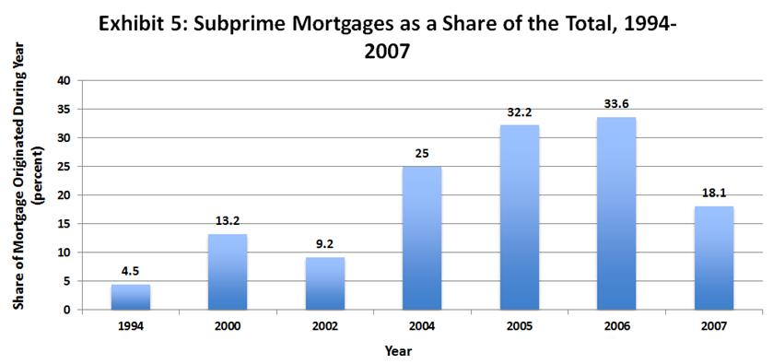
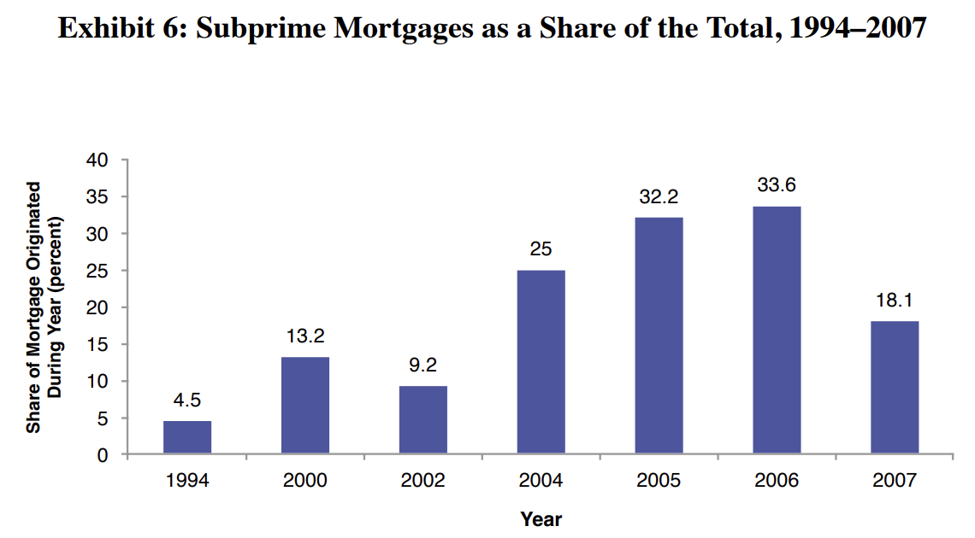
In order meet the HUD mandates, Fannie and Freddie reduced lending standards and extended more loans to sub-prime borrowers.
Sub-prime mortgages soared from 4.5 percent of the new mortgages in 1994, to 13.2 percent in 2000 and 32 percent in 2005-2006.
Source: The 1994-2000 data are from Edward M. Gramlich, Financial Services Roundtable Annual Housing Policy Meeting, Chicago, Illinois,
21 May 2004. The 2002-2007 data are from the Joint Center for Housing Studies of Harvard University, The State of the Nations Housing 2008.

Slide 44
SECONDARY EFFECTS OF MORTGAGE MARKET REGULATIONS
The impact of declining lending standards:
  Initially, the lower lending standards led to an increase in demand for, and price of, housing.
  But, the artificially created housing boom was not sustainable. As soon as prices leveled off and then began to decline during the second half of 2006, both the default and foreclosure rates soared. This occurred well before the 2008-2009 recession.
  By summer 2008, Fannie Mae and Freddie Mac were insolvent.

Slide 45
SECONDARY EFFECTS OF MORTGAGE MARKET REGULATIONS CONTINUED…
The interest rate policies of the Federal Reserve also contributed to the recession of 2008.
But the political allocation of credit and accompanying regulatory erosion of lending standards channeled a lot of financial capital into counterproductive projects - projects that should never have been undertaken.

Slide 46
CSE 2.5
MONETARY STABILITY: A STABLE MONETARY POLICY IS ESSENTIAL FOR THE CONTROL OF INFLATION, EFFICIENT ALLOCATION OF INVESTMENT, AND ACHIEVEMENT OF ECONOMIC STABILITY.
If a country is going to grow and prosper, a stable monetary policy is essential for the
  Control of inflation
  Efficient allocation of investment
  Achievement of economic stability

Slide 47
MONEY
Money is to an economy what language is to communication.
Money of stable value enhances the gains from trade.
If money has a stable and predictable value, it will reduce the uncertainty accompanying transactions across time.
For example, it will be easier for borrowers and lenders to find mutually acceptable terms for loans and for many individuals to engage in time-dimension transactions (such as borrowing or lending for a house, automobile, capital equipment, education, business and the like over time) with some degree of certainty.

Slide 48
MONEY:
THREE PRIMARY FUNCTIONS
Medium of exchange
Store of value
Unit of account

Slide 49
MONEY: MEDIUM OF EXCHANGE
Money simplifies transactions, such as when you use cash or your debit card to buy gas or purchase coffee from a café, which is more straightforward than bartering clothes, other goods, or your services in exchange for what you want to purchase.
When you bought your textbook at a bookstore or online, you paid with cash or using your debit card, eliminating the need to exchange goods in your possession or your services for the book.

Slide 50
MONEY: STORE OF VALUE
Money can be saved and retrieved in the future without losing purchasing power, unlike perishable items. This feature enables you to deposit money into a savings account today and withdraw it later to purchase a car.
Example: You receive a paycheck and decide to put a portion into a savings account to eventually use for car, college, or as a down payment on a house, demonstrating money's ability to store value for future use.

Slide 51
MONEY: UNIT OF ACCOUNT
Money allows us to assign a specific value to goods and services, enabling us to quantify the cost of a new smartphone as "$799," rather than trying to express its value in terms of other goods like cows or wheat.
Example: When comparing the price of smartphones across different vendors, money acts as a unit of account that helps you determine which vendor offers the more economical option relative to the features and capabilities.

Slide 52
INFLATION
Inflation is an increase in the general level of prices, not merely an increase in the price of a few items such as gasoline, meat, and air travel.
Rapid increases in the supply of money cause inflation.
Inflation generates uncertainty, reduces the gains from trade, and, thereby, retards economic growth.
The consumer price index (CPI) is the most widely used measure of inflation, reflecting the cost of purchasing the bundle of goods and services consumed by the typical household.

Slide 53
MEASUREMENT AND CONTROL OF MONEY
  The money supply of a nation is controlled by its central bank. In the U.S., the central bank is the Federal Reserve Bank or the Fed.
  The M1 money supply consists of currency held by the public, checking accounts, and traveler’s checks. The components of the M1 money supply can be used readily to buy goods and services.
  The M2 money supply is a broader measure of money that includes various savings accounts.

Slide 54
THE VALUE OF MONEY
The value of money is determined by the supply of, and demand for, money.
The value of money is steady when the supply of money grows slowly – for example – at approximately the same rate as goods and services.
When a central bank expands the money supply rapidly relative to the production of goods and services, inflation results because there are too many units of money (for example, dollars) chasing too few goods and services.

Slide 55
Primary Cause of Inflation Is:
Rapid growth in the money supply relative to the production of goods and services
  Results in too much currency chasing too few goods
  Prices rise
  The purchasing power of each unit of currency decreases, distorting the information conveyed to consumers and producers

Slide 56
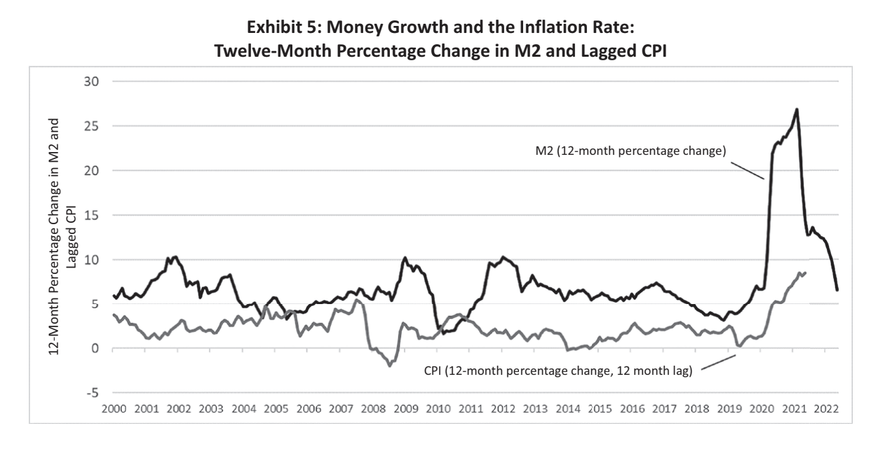

Slide 57
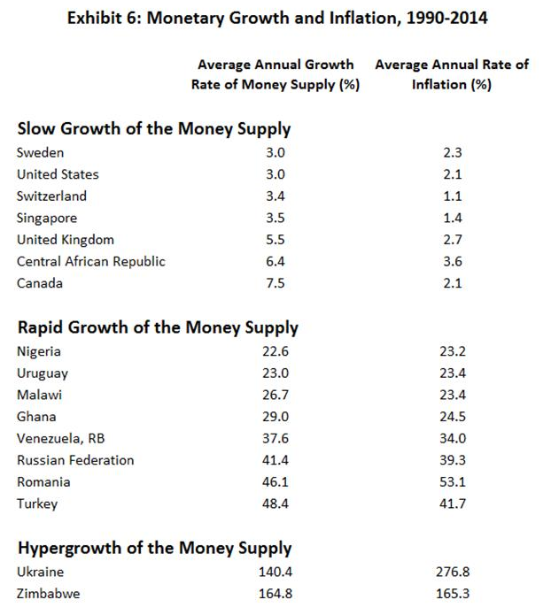
THE LINKAGES BETWEEN VARIOUS RATES OF GROWTH OF THE MONEY SUPPLY AND INFLATION
Inflation is caused by rapid increases in the supply of money.
The evidence presented in exhibit 6 supports this claim.
Source: The World Bank, World Development Indicators, 2015 and International Monetary Fund, International Financial Statistics (annual).

Slide 58
MONETARY POLICY AND THE GREAT RECESSION
Expansionary monetary policy during 2002-2004 pushed interest rates to historic low levels.
Along with regulations promoting easy credit for housing, the low interest rates of 2002-2004 generated a boom in housing prices.

Slide 59
MODULE 6: QUESTIONS FOR THOUGHT
Would an increase in the minimum wage be an effective way to reduce the poverty rate? Why or why not?
What is the motivation for occupational licensing? Who is helped and who is hurt by occupational licensing?

Slide 60
MODULE 6: QUESTIONS FOR THOUGHT
How did the combination of regulations promoting loose mortgage lending standards and the Fed’s artificially low interest-rate policies influence the boom and bust in the housing market and the soaring default rates and Great Recession that followed?
How does money of stable value influence the volume of trade? How will this influence economic growth and prosperity?

Slide 61
MODULE 7: IMPACT OF TAXES AND INTERNATIONAL TRADE
CSE 2.6, 2.7, Economic Freedom, and Final Thoughts
ELEMENTS
CSE 2.6 Low tax rates: People produce more when they can keep more of what they earn.
CSE 2.7 Free trade: People achieve higher incomes when they are free to trade with individuals in other countries.

Slide 62
MODULE 7: IMPACT OF TAXES AND INTERNATIONAL TRADE
CSE 2.6, 2.7, Economic Freedom, and Final Thoughts
CONCEPTS
  Taxes, incentives, and productive activity
  Gains from international trade
  Economics, politics, and trade restrictions
  Economic freedom, growth, and income

Slide 63
MODULE 7: IMPACT OF TAXES AND INTERNATIONAL TRADE
CSE 2.6, 2.7, Economic Freedom, and Final Thoughts
STANDARDS
There is an economic role for government in a market economy whenever the benefits of a government policy outweigh its costs. Governments often provide for national defense, address environmental concerns, define and protect property rights, and attempt to make markets more competitive. Most government policies also have direct or indirect effects on peoples’ incomes. (Standard 16: Role Of Government And Market Failure, PDF) Unemployment imposes costs on individuals and the overall economy. Inflation, both expected and unexpected, also imposes costs on individuals and the overall economy. Unemployment increases during recessions and decreases during recoveries. (Standard 19: Unemployment And Inflation, PDF) Costs of government policies sometimes exceed benefits. This may occur because of incentives facing voters, government officials, and government employees, because of actions by special interest groups that can impose costs on the general public, or because social goals other than economic efficiency are being pursued. (Standard 17: Government Failure, PDF) Fluctuations in a nation’s overall levels of income, employment, and prices are determined by the interaction of spending and production decisions made by all households, firms, government agencies, and others in the economy. Recessions occur when overall levels of income and employment decline. (Standard 18: Economic Fluctuations, PDF)

Slide 64
CSE 2.6
LOW TAX RATES: PEOPLE PRODUCE MORE WHEN THEY CAN KEEP MORE OF WHAT THEY EARN.
Taxes are paid in the sweat of every man who labors. If those taxes are excessive, they are reflected in idle factories, in tax-sold farms, and in hordes of hungry people tramping streets and seeking jobs in vain.
—Franklin D. Roosevelt,
Pittsburgh, October 19, 1932

Slide 65
MARGINAL TAX RATES AND INCENTIVE TO EARN
The marginal tax rate is the additional tax liability divided by addition income.
It is important because it determines the share of additional income the taxpayer is permitted to keep.
High marginal tax rates:
  discourage work effort and reduce the productivity of labor.
  reduce both the level and efficiency of capital formation.
  encourage individuals to consume tax-deductible goods when nondeductible goods may actually be more desirable.

Slide 66
MAJOR TAX REDUCTIONS: HISTORICAL EXAMPLES
Reductions in tax rates, particularly high rates, can increase the incentive to earn and improve the efficiency of resource use.
The United States has had three major reductions in tax rates:
  the rate reductions during the 1920s in the aftermath of World War I
  the Kennedy tax cuts of the 1960s
  the Reagan tax cuts of the 1980s
All were followed by strong and lengthy expansions in real output.

Slide 67
TAX POLICY AND THE GREAT DEPRESSION
Large tax increases can exert a disastrous impact on the economy.
A large personal income tax increase was adopted in 1932 in the midst of the Great Depression.
  The top marginal rate was increased from 25 percent to 63 percent in 1932. Other income tax rates were increased by a similar proportion.
  The results were disastrous. In 1932, real output fell by 13 percent, the largest single-year decline during the Great Depression era. Unemployment rose from 15.9 percent in 1931 to 23.6 percent in 1932.
In 1936, the Roosevelt Administration increased the top marginal rate to 79 percent. Recession and rising unemployment also followed this tax increase.

Slide 68
HIGH IMPLICIT MARGINAL TAX RATES
Many people with relatively low incomes often confront high implicit marginal tax rates once the combination of additional taxes and the loss of transfer benefits is considered.
These high marginal tax rates substantially reduce the incentive to earn and make it more difficult for many to move up the income ladder.
These high implicit rates also reduce productive activity, impede both employment and investment, and promote wasteful use of resources.

Slide 69
CSE 2.7
FREE TRADE: PEOPLE ACHIEVE HIGHER INCOMES WHEN THEY ARE FREE TO TRADE WITH PEOPLE IN OTHER COUNTRIES.
Free trade consists simply in letting people buy and sell as they want to buy and sell. Protective tariffs are as much applications of force as are blockading squadrons, and their objective is the same—to prevent trade. The difference between the two is that blockading squadrons are a means whereby nations seek to prevent their enemies from trading; protective tariffs are a means whereby nations attempt to prevent their own people from trading.
— Henry George

Slide 70
KEY PRINCIPLE OF INTERNATIONAL TRADE
A nation progresses by selling goods and services that it can produce at a relatively low cost and trading for those that would be costly to produce domestically.
  Exchange makes it possible for both trading partners to expand their production and consumption.

Slide 71
MONETARY POLICY AND ECONOMIC STABILITY
Shifts in monetary policy exert an impact on output and prices with a time lag.
The time lags of monetary policy are variable and sometimes quite lengthy.
Because of these time lags, persistent shifts back and forth from restrictive to expansionary monetary policy are likely to do more harm than good. They are likely to be a source of economic instability.

Slide 72
GAINS FROM INTERNATIONAL TRADE
There are three major sources of gains from trade.
International trade:
  Benefits people when they can acquire a product or service through trade more cheaply than they can produce it domestically.
  Allows domestic producers and consumers to benefit from economies of scale.
  Promotes competition in domestic markets and allows consumers to purchase a wider variety of goods at lower prices.

Slide 73
BARRIERS TO TRADE
Include tariffs on imports, domestic subsidies, quotas on imports, bureaucratic red tape, etc.
Create inefficiencies in the protected industries, raise the cost of doing business with those protected industries, and force domestic consumers to pay higher prices than would be the case with free trade.
Reshuffle employment. They do not create or destroy domestic jobs.

Slide 74
IMPORTS, EXPORTS, AND TRADE REMINDERS
Imports are the products and services produced in one country and purchased by residents of another. They are advantageous as they provide international access to goods and services at lower costs, freeing up domestic resources for other uses and making available products and inputs not available domestically.
Exports are the goods and services produced in one country and sold producers and consumers in another. Exports provide a country’s producers with access to larger markets, often leading to higher sales volumes and better prices than in their home market.
International trade increases the variety of goods available, enhances consumption and investment possibilities, and generally improves economic efficiency..

Slide 75
THE LINK BETWEEN IMPORTS, EXPORTS, AND TRADE RESTRICTIONS
Trade restrictions that reduce imports will also reduce the ability of foreigners to buy our exports.
Quotas and tariffs decrease the number of dollars earned by foreigners through the sale of imports to us.
Therefore, reductions in imports simultaneously reduce exports.

Slide 76
IS THE UNITED STATES A FREE TRADE COUNTRY?
Many Americans think the U.S. practices free trade, but that is not entirely true.
  The U.S. imposes tariffs of 10 percent or higher on more than 1,000 product categories, including footwear and apparel.
  The U.S. also imposes quotas on dairy products, sugar, ethanol, cotton, beef, canned tuna, and tobacco.
  Further, procedures imposed in the aftermath of September 11, 2001, still make it both more costly and time-consuming to clear goods through customs.

Slide 77
GLOBALIZATION AND POVERTY
Lower transportation costs and reductions in trade barriers have substantially increased the volume of international trade during the past three decades.
The reduction in trade barriers has been most pronounced in low-income countries. Beginning in the 1980s, numerous less-developed countries including China and India lowered their tariffs, relaxed exchange rate controls, and removed other trade barriers.

Slide 78
GLOBALIZATION AND POVERTY CONTINUED BUT…
The growth of international trade has made it possible for the world to produce a larger output and achieve a higher level of consumption than otherwise would have been the case. The poor in particular have benefited from the freer trade, and worldwide, nearly a billion people moved out of extreme poverty in the 20 years from 1990 to 2010.
Further, the growth of international trade has narrowed the income gap between rich and poor nations. Less-developed countries have grown more rapidly than high-income developed nations. The distribution of income worldwide is now more equal than it was in 1980.

Slide 79
MOTIVATION FOR TRADE BARRIERS: EARNINGS INEQUALITY
Motivation for Trade Barriers
  In high-income countries, trade openness may increase earnings inequality. These countries tend to export goods requiring lots of high-skill, well-educated labor while disproportionately importing goods produced by low-skill labor.
  This can contribute to earnings inequality and generates hostility toward international trade.

Slide 80
MOTIVATION FOR TRADE BARRIERS: SPECIAL INTEREST POLITICS
Special interest politics also generates demand for trade restrictions.
  Trade restrictions benefit producers and workers in specific industries at the expense of consumers. The gains of the industries lobbying for the trade restrictions are visible and concentrated, while the consumers are poorly organized, and the costs imposed on them are widely dispersed. Predictably, the special interests will have more political clout, providing politicians with a strong incentive to cater to their views.
History demonstrates the danger of trade barriers. Hostility toward trade in 1930 led to the passage of the notorious Smoot-Hawley trade bill.

Slide 81
THE SMOOT-HAWLEY TRADE BILL OF 1930
The bill increased tariffs on more than 3200 goods by approximately 50 percent.
The volume of trade declined sharply.
The economy fell deeper into recession and the unemployment rate soared.
  Unemployment stood at 7.8 percent when the Smoot-Hawley bill was passed, but it ballooned to 23.6 percent of the labor force just two years later.
The stock market, which had been above 280 at passage, fell below 90 in the two years following its passage.

Slide 82
ECONOMIC FREEDOM, GROWTH, AND INCOME
The seven elements of this section imply that institutions and policies supportive of economic freedom will generate more rapid growth and lead to higher income levels.
Is this really true? What do the data reveal?

Slide 83
HOW IMPORTANT ARE INSTITUTIONS AND POLICIES?
Economic Freedom and Its Impact on Prosperity
Economic theory suggests that institutions and policies play a crucial role in economic performance.
The Economic Freedom of the World (EFW) index, developed by the Fraser Institute, measures the degree of economic freedom in countries across the globe.
The EFW index considers factors like government size, property rights, sound money, international exchange, and regulation.
Countries with higher EFW ratings tend to exhibit greater economic prosperity and growth compared to those with lower ratings.

Slide 84
ECONOMIC FREEDOM:
A TALE OF TWO EXTREMES
Top 10 Most-Free Economies
Bottom 10 Least-Free Economies
Hong Kong, Singapore, Switzerland, New Zealand, United States, etc.
Average per capita income of the top-ten: $62,476
Their average annual per capita GDP growth: 1.7%
Algeria, Republic of Congo, Democratic Republic of the Congo, Myanmar, Venezuela, etc.
Average per capita income of the bottom-ten: $4,520
Their average annual per capita GDP growth: 1.41%
The data underscores the significant impact of economic freedom on income levels and economic growth.

Slide 85
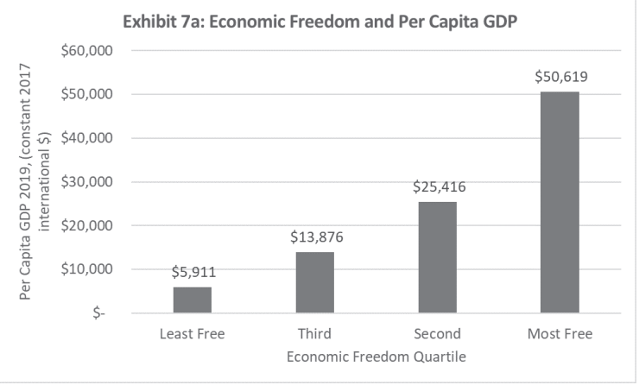

Slide 86
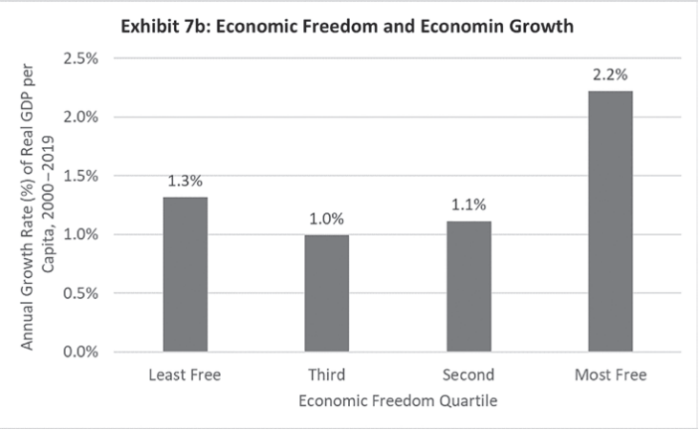

Slide 87
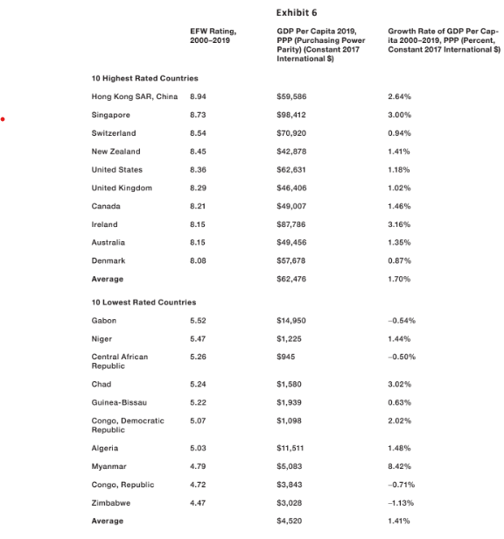
  The countries with the highest levels of economic freedom have the highest per capita GDP and growth rates.
  The countries with the lowest levels of economic freedom have the lowest per capita GDP and growth rates.
Sources: J. Bolt and J. van Zanden, “Maddison Style Estimates of the Evolution of the World Economy: A New 2020 Update,” Groningen Growth and Development Center, October 2020, Gwartney et al., Economic Freedom of the World: 2021 Annual Report (Vancouver: Fraser Institute, 2021); and World Bank,
World Development Indicators (2022).

Slide 88
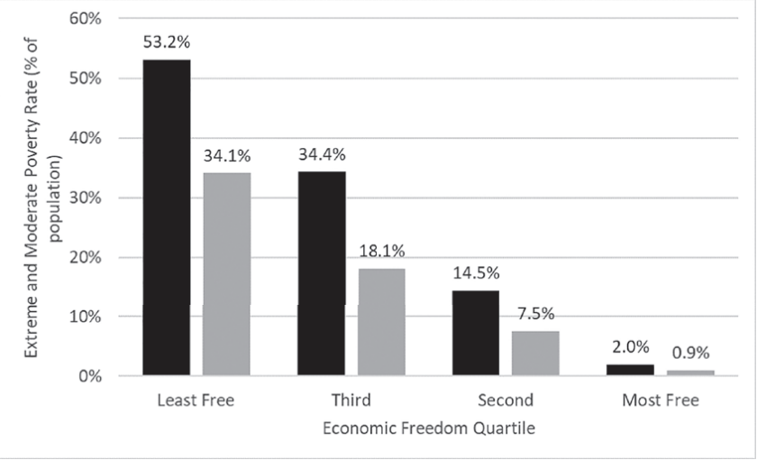
Exhibit 8: Economic Freedom and Extreme and Moderate Poverty Rates
In countries with the highest levels of freedom, the average per capita income is nearly eight times higher, and their growth rates are almost twice as high compared to the least free countries.
Source: Fraser Institute, Economic Freedom of the World: 2015 Annual Report

Slide 89
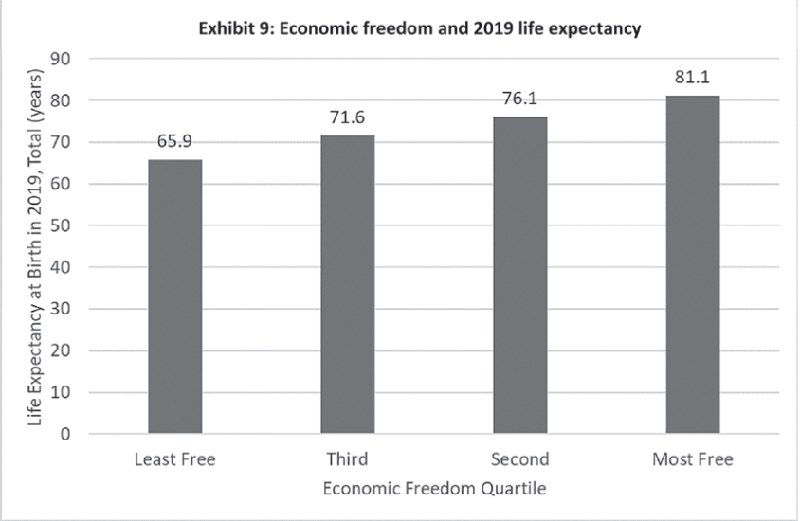
Poverty rates are also lower. Life expectancy is higher. Plus, environmental performance is better in countries with relatively high economic freedom.
Sources: Fraser Institute, Economic Freedom of the World: 2015 Annual Report, World Development Indicators

Slide 90
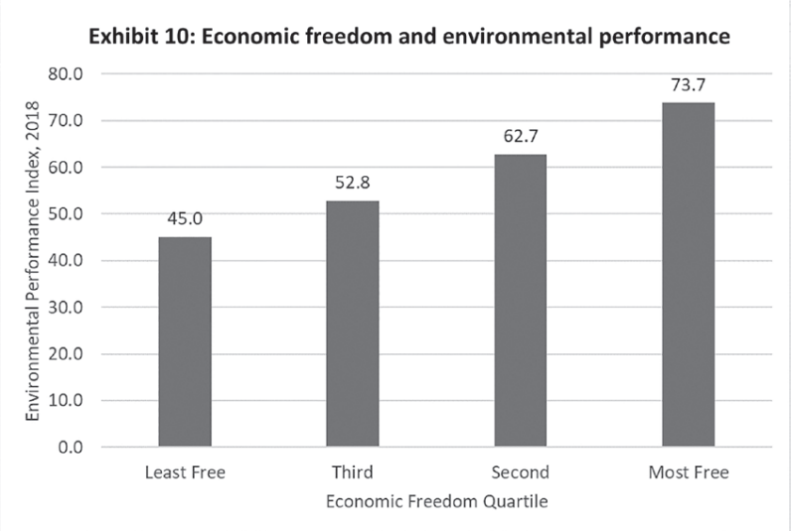

Slide 91
ECONOMIC INSTITUTIONS AND PROSPERITY
Countries with institutional arrangements that follow policies consistent with the seven sources of economic growth, grow more rapidly and achieve higher income levels.
When low-income countries get the institutions and policies right, they can achieve exceedingly high growth rates and narrow the income gap relative to high-income industrial nations.
  This is a major contributing factor to the sharp reduction in poverty since 1980. In 2005, the world’s extreme poverty rate was 25 percent, down from 58 percent in 1980.

Slide 92
TECHNOLOGY, TRADE, ENTREPRENEURSHIP, AND THE REMARKABLE GROWTH OF THE PAST HALF CENTURY
For most of human history, there was little change in per capita income as measured by real GDP per person indicating the world lived in extreme poverty.
Around 1800, technological improvements and capital formation propelled incomes upward in the West. This was attributed to the Industrial Revolution.
However, income levels in the rest of the world remained at or near subsistence levels.
In the past half-century, developing countries have grown rapidly, experiencing remarkable change due to the Transportation-Communication Revolution.

Slide 93
Economic Progress Since 1970: Key Drivers
Huge reduction in the real cost of transportation and communication:
  Cost per ton of ocean shipping declined by >50% during 1974-2016
  Air freight shipping cost per ton-kilometer declined by an even larger amount
  Standardized steel container and mechanization reduced cost of loading/unloading ocean freighter cargo by 99%
  Dramatic cost reductions in communication

Slide 94
Technology-Communication Revolution’s Impact the Economy
Substantial Increase in International Trade:
  Increased gains from entrepreneurial activities
  Improved economic institutions
  Enhanced economic performance worldwide, particularly in developing countries
International Trade and GDP
  1960s: International trade averaged 19% of world output
  2010: International trade reached approximately 50% of world GDP

Slide 95
The Impact of Lower Transportation and Communication Costs
Larger gains from entrepreneurship: Businesses in developing countries can adopt successful technologies and practices from advanced economies at a low cost.
Improved institutions and policies: Reduced costs give entrepreneurs and investors more flexibility, encouraging policymakers to adopt sound institutions and policies.
Positive secondary effects: Increased incentive to remove trade barriers and improve legal systems in developing countries.

Slide 96
Factors Influencing Economic Growth in Developing Countries
Geographic factors: Location and climate play a significant role in economic growth.
  Location: Countries distant from major markets face higher trade costs and fewer trading partners. Limited ocean access further reduces attractiveness for business activity.
  Climate: Hot, disease-prone climates hinder economic activity, including labor productivity and disease immunity.
Technology-Communication Revolution benefits all countries around the global with those with geographic constraints benefiting the least.

Slide 97
MODULE 7: QUESTIONS FOR THOUGHT
Why are the implicit marginal tax rates (including both taxes owed and loss of transfer benefits) of those with relatively low incomes so high? How does this influence income mobility in the United States?
How have the barriers to international trade changed during the past three decades? What impact have these changes had on the income levels of poor nations relative to those with higher incomes?
What was the central message of Part 2 of Common Sense Economics? Is this view supported by sound reasoning and data? Is it widely understood by Americans?

